Slide 1
Concat IP and AXI Timer Controller
By Dr. Min He

Slide 2
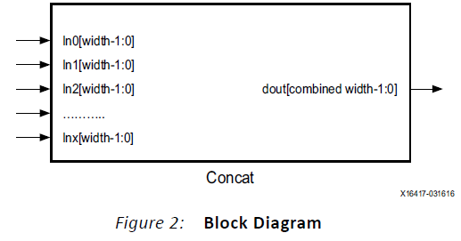
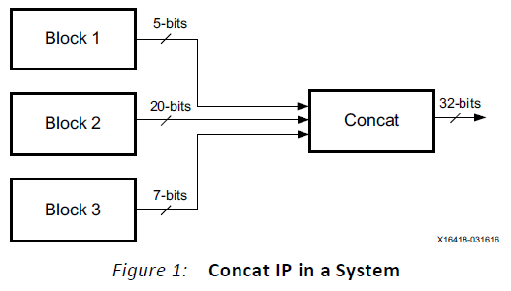
Concat IP
The Concat IP core provides a mechanism to combine bus signals of varying width into a single bus.

Slide 3
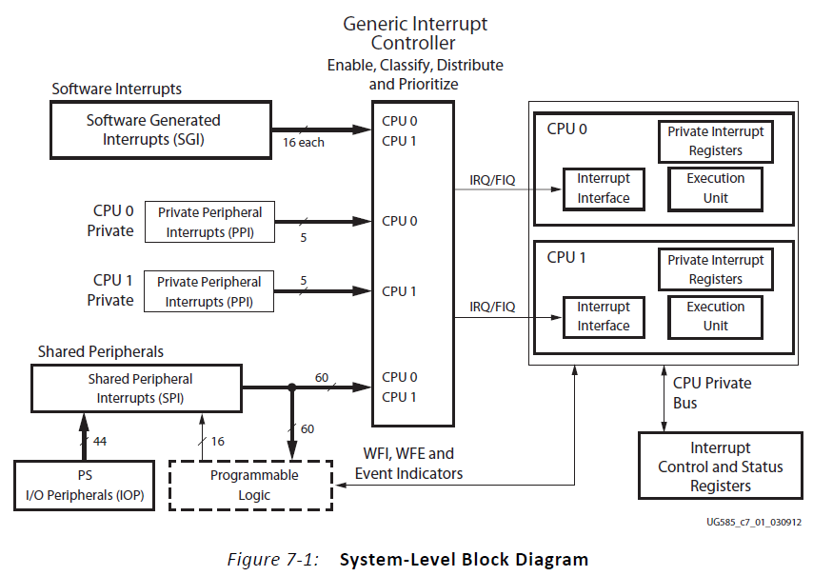
GIC System-Level Block Diagram

Slide 4
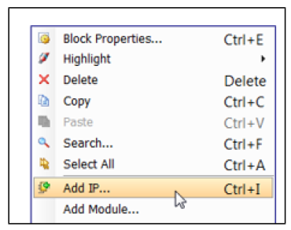
Using Concat in a Block Design
In a block design you instantiate the Concat IP core

Slide 5
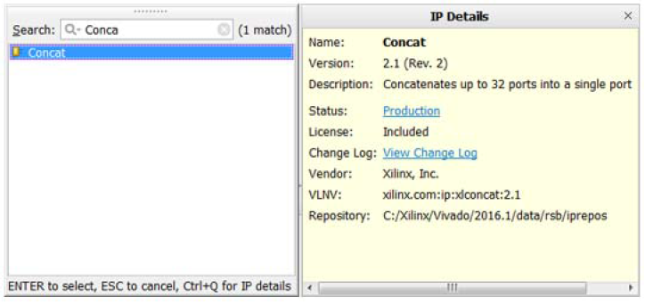
In the Search field of the IP Catalog, type Concat and double-click the Concat IP core to instantiate it.

Slide 6
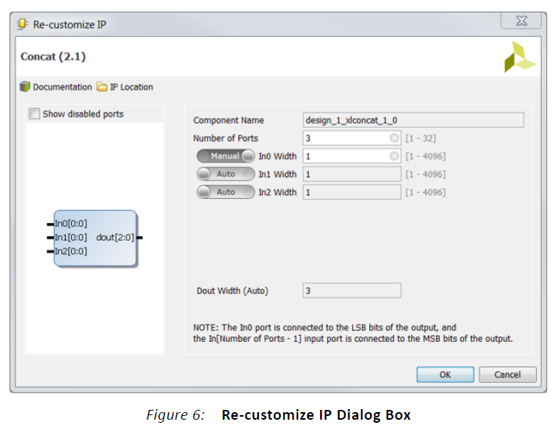
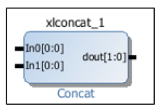
Customize Concat IP
Concat IP before customize
Notes:
In Figure 6, set the Number of Ports parameter to the number of input ports desired. To set the bit
width of an input port, toggle the button to the left of the Inx Width field to Manual which makes
the Inx Width field editable. Enter the bit width in the field. The output bit width is the combined
bit widths of all the input ports and is shown in the Dout Width field.

Slide 7
AXI Timer
The AXI Timer is organized as two identical timer modules.
Each timer module has an associated load register to hold the initial value for the counter for generate mode, or capture value for capture mode.
All of the timer/counter interrupts are OR’ed together to generate a single external interrupt signal.
The interrupt service routine reads the control/status registers to determine the source of the interrupt.
Notes:
Each timer module has an associated load register that is used to hold either the initial value for
the counter for event generation or a capture value, depending on the mode of the timer.
The generate value, which is the value loaded into the load register, is used to generate a
single interrupt at the expiration of an interval or a continuous series of interrupts with a
programmable interval. The capture value is the timer value that has been latched on
detection of an external event. The clock rate of the timer modules is s_axi_aclk (no
prescaling of the clock is performed). All of the timer/counter interrupts are OR’ed together
to generate a single external interrupt signal. The interrupt service routine reads the
control/status registers to determine the source of the interrupt.

Slide 8
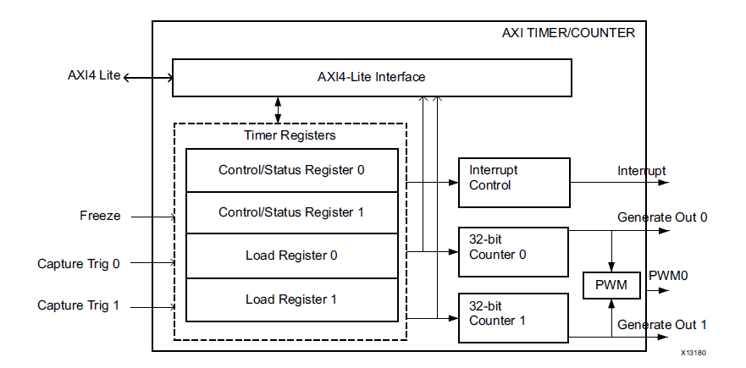
Block Diagram of AXI Timer

Slide 9
Operation Overview
AXI4-Lite Interface: The AXI4-Lite Interface module implements an AXI4-Lite slave interface for accessing memory mapped Timer registers.
Timer Registers: The Register block implements a set of 32-bit registers for each timer/counter. This set of register contains load register, timer/counter register and control/status register.
32-bit Counters: The Timer/Counter module has two 32-bit counters, each of which can be configured for up/down counts and can be loaded with a value from the load register.

Slide 10
Operation Overview – cont’d
Interrupt Control: The Interrupt control module generates a single interrupt depending on the mode of operation.
Pulse Width Modulation (PWM): The PWM block generates a pulse signal, PWM0, with a specified frequency and duty factor. It uses Timer 0 for PWM0 period, and Timer 1 for PWM0 output width.

Slide 11
Timer Modes
Generate Mode: for generating repetitive interrupts or external signals with a specified interval.
Capture Mode: for time-tagging external events
Pulse Width Modulation Mode: two timer/counters are used as a pair to produce an output signal (PWM0) with a specified frequency and duty factor.
Cascade Mode: the two timer/counters are cascaded to operate as a single 64-bit counter/timer.

Slide 12
Interrupts
The TC interrupt signals can be enabled or disabled with the Enabel Interrupt for Timer (ENIT) bit in the TCSR.
The interrupt status bit (TINT) in the TCSR cannot be disabled and always reflects the current state of the timer interrupt.
In Generate mode, a timer interrupt is caused by the counter rolling over (the same condition used to reload the counter when ARHT is set to 1).

Slide 13
Applications
Applications of this core include:
Clock generation with different time periods and duty cycle
Pulse generation circuits
Generating time-related interrupts
Pulse Width Modulation signal for motor control

Slide 14
AXI Timer Driver Functions
XTmrCtr_Initialize
XTmrCtr_SetHandler
XTmrCtr_SetResetValue
XTmrCtr_SetOptions
XTmrCtr_Start
XTmrCtr_Stop
XTmrCtr_IsExpired
XTmrCtr_Reset

Slide 15
Reference
Concat product brief: pb041-xilinx-com-ip-xlconcat.pdf
AXI Timer 2.0 Product Guide: pg079-axi-timer.pdf

